Slide 1

Operating Systems Design​ Session 26: User Process Address Space
19CS2106R​
© 2020 KL University

Slide 2
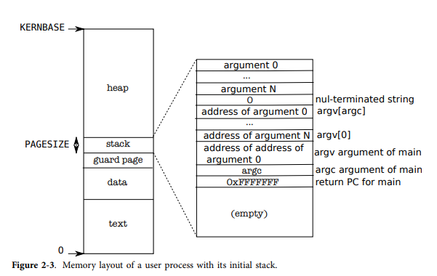
User part of an address space
Starts at 0 limit is KERNBASE
Stack is single page
Arguments and main function
xv6 places a guard page right below the stack.

Slide 3
exec
Exec is the system call that creates the user part of an address space
It initializes the user part of an address space from a file stored in the file system.
exec (6610) opens the named binary path using namei (6623).
Check ELF File and create page directory
Loads ELF File into memory just like Kernel Image
Create a Guard page
Create a user stack
Discard Calling process

Slide 4
1. exec (6610) opens the named binary path using namei (6623).
6621 begin_op();
6622
6623 if((ip = namei(path)) == 0){
6624 end_op();
6625 cprintf("exec: fail\n");
6626 return −1;
6627 }
6628 ilock(ip);
6629 pgdir = 0;

Slide 5
2. Check ELF header and create pgdir
6631 // Check ELF header
6632 if(readi(ip, (char*)&elf, 0, sizeof(elf)) != sizeof(elf))
6633 goto bad;
6634 if(elf.magic != ELF_MAGIC)
goto bad;
6636
6637 if((pgdir = setupkvm()) == 0)
6638 goto bad; 6639
6705 bad:
6706 if(pgdir)
6707 freevm(pgdir);
6708 if(ip){
6709 iunlockput(ip);
6710 end_op();
6711 }
6712 return −1;
6713 }

Slide 6
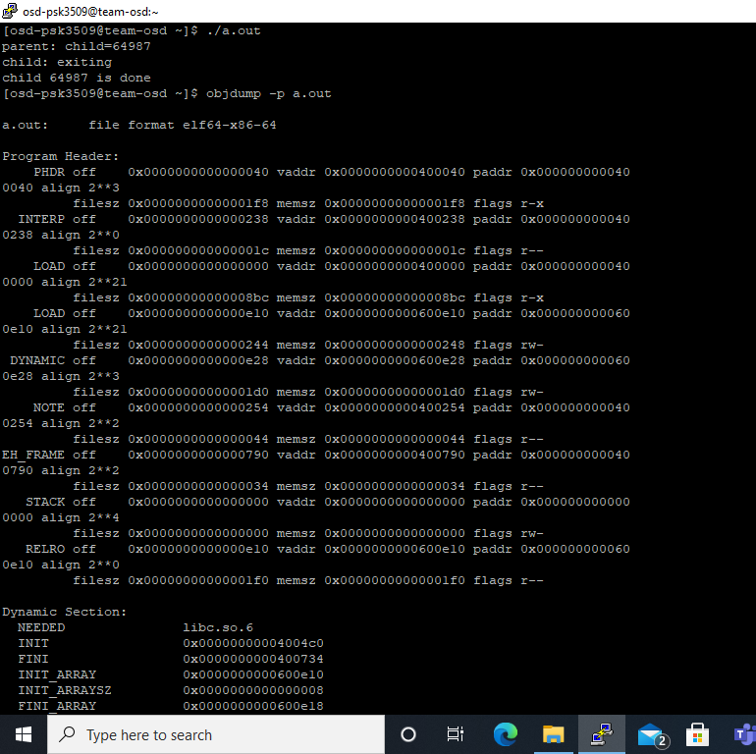
Check ELF

Slide 7
3. Load Program(ELF) to Memory (Like Loading Kernel Image by bootmain.c
6640 // Load program into memory.
6641 sz = 0;
6642 for(i=0, off=elf.phoff; i<elf.phnum; i++, off+=sizeof(ph)){
6643 if(readi(ip, (char*)&ph, off, sizeof(ph)) != sizeof(ph))
6644 goto bad;
6645 if(ph.type != ELF_PROG_LOAD)
6646 continue;
6647 if(ph.memsz < ph.filesz)
6648 goto bad;
if(ph.vaddr + ph.memsz < ph.vaddr)
6650 goto bad;
6651 if((sz = allocuvm(pgdir, sz, ph.vaddr + ph.memsz)) == 0)
6652 goto bad;
6653 if(ph.vaddr % PGSIZE != 0)
6654 goto bad;
6655 if(loaduvm(pgdir, (char*)ph.vaddr, ip, ph.off, ph.filesz) < 0)
6656 goto bad;
6657 }
allocates memory for each ELF segment with allocuvm (6651)
loads each segment into
memory with loaduvm (6655)

Slide 8
4. Create a Guard page
6664 sz = PGROUNDUP(sz);
6665 if((sz = allocuvm(pgdir, sz, sz + 2*PGSIZE)) == 0)
6666 goto bad;
6667 clearpteu(pgdir, (char*)(sz − 2*PGSIZE));
6668 sp = sz;
Allocate two pages at the next page boundary.
Make the first inaccessible using clearpteu
2019 // Clear PTE_U on a page. Used to create an inaccessible
2020 // page beneath the user stack.
2021 void
2022 clearpteu(pde_t *pgdir, char *uva)
2023 {
2024 pte_t *pte;
2025
2026 pte = walkpgdir(pgdir, uva, 0);
2027 if(pte == 0)
2028 panic("clearpteu");
2029 *pte &= ~PTE_U;
2030 }

Slide 9
5. Create a user stack
6670 // Push argument strings, prepare rest of stack in ustack.
6671 for(argc = 0; argv[argc]; argc++) {
6672 if(argc >= MAXARG)
6673 goto bad;
6674 sp = (sp − (strlen(argv[argc]) + 1)) & ~3;
6675 if(copyout(pgdir, sp, argv[argc], strlen(argv[argc]) + 1) < 0)
6676 goto bad;
6677 ustack[3+argc] = sp;
6678 }
6679 ustack[3+argc] = 0;
6680
6681 ustack[0] = 0xffffffff; // fake return PC
6682 ustack[1] = argc;
6683 ustack[2] = sp − (argc+1)*4; // argv pointer
6684
6685 sp −= (3+argc+1) * 4;
6686 if(copyout(pgdir, sp, ustack, (3+argc+1)*4) < 0)
6687 goto bad;
6688
Now exec allocates and initializes the user stack.
It allocates just one stack page.
Exec copies the argument strings to the top of the stack one at a time, recording the pointers to them in ustack.
The first three entries in ustack are the fake return PC, argc, and argv pointer.
deal with arguments that are too large;

Slide 10
copyout
it converts a user-space address to a kernel-space address
2114 // Copy len bytes from p to user address va in page table pgdir.
2115 // Most useful when pgdir is not the current page table.
2116 // uva2ka ensures this only works for PTE_U pages.
2117 int
2118 copyout(pde_t *pgdir, uint va, void *p, uint len)
2119 {
2120 char *buf, *pa0;
2121 uint n, va0;
2122
2123 buf = (char*)p;
2124 while(len > 0){
2125 va0 = (uint)PGROUNDDOWN(va);
2126 pa0 = uva2ka(pgdir, (char*)va0);
2127 if(pa0 == 0)
2128 return −1;
2129 n = PGSIZE − (va − va0);
The key of the function is to ﬁnd the corresponding address in the kernel space (i.e. the current memory space) for va using uva2ka(). The rest of the function is just a routine page-by-page copying
2130 if(n > len)
2131 n = len;
2132 memmove(pa0 + (va − va0), buf, n);
2133 len −= n;
2134 buf += n;
2135 va = va0 + PGSIZE;
2136 }
2137 return 0;
2138 }

Slide 11
uva2ka
Map user virtual address to kernel address.
2100 // Map user virtual address to kernel address.
2101 char*
2102 uva2ka(pde_t *pgdir, char *uva)
2103 {
2104 pte_t *pte;
2105
2106 pte = walkpgdir(pgdir, uva, 0);
2107 if((*pte & PTE_P) == 0)
2108 return 0;
2109 if((*pte & PTE_U) == 0)
2110 return 0;
2111 return (char*)P2V(PTE_ADDR(*pte));
2112 }

Slide 12
6. Discard Calling Process
Exec must wait to free the old image until it is sure that the system call will succeed:
If the old image is gone, the system call cannot return –1 to it.
The only error cases in exec happen during the creation of the image.
Once the image is complete, exec can install the new image (6701) and free the old one (6702).
Finally, exec returns 0.
6695 // Commit to the user image.
6696 oldpgdir = curproc−>pgdir;
6697 curproc−>pgdir = pgdir;
6698 curproc−>sz = sz;
6699 curproc−>tf−>eip = elf.entry; // main
6700 curproc−>tf−>esp = sp;
6701 switchuvm(curproc);
6702 freevm(oldpgdir);
6703 return 0;

Slide 13
sbrk - process to shrink or grow its memory
2555 // Grow current process’s memory by n bytes.
2556 // Return 0 on success, −1 on failure.
2557 int
2558 growproc(int n)
2559 {
2560 uint sz;
2561 struct proc *curproc = myproc();
2562
2563 sz = curproc−>sz;
2564 if(n > 0){
2565 if((sz = allocuvm(curproc−>pgdir, sz, sz + n)) == 0)
2566 return −1;
2567 } else if(n < 0){
2568 if((sz = deallocuvm(curproc−>pgdir, sz, sz + n)) == 0)
2569 return −1;
2570 }
2571 curproc−>sz = sz;
2572 switchuvm(curproc);
2573 return 0;
2574 }
The system call is implemented by the function growproc
If n is postive, growproc allocates one or more physical pages and maps them at the top of the process’s address space.
If n is negative, growproc unmaps one or more pages from the process’s address space and frees the corresponding physical pages.

